Slide 1














City Typhoon
Safety System
INFO 5100 FINAL PROJECT
A digital application with data management and platform of rescue, supply, news center collection to ensure residents’ walth and health safety.
Contributors：
Qian Yu, Jialai Wu,
Minghui Qiu

Slide 2












CONTENTS
01
Brief Introduction
We aiming to develop this app to help more people.
02
Sequence Diagram
Hierarchy and sequence diagram of the project.
03
Unique Features
Data analysis, roles cooperation, geographic applied.
04
Application Demo
Show how fur we can go in this application.

Slide 3







Brief Introduction
Save More Lives
Help More People
Reduce More Risks

Slide 4
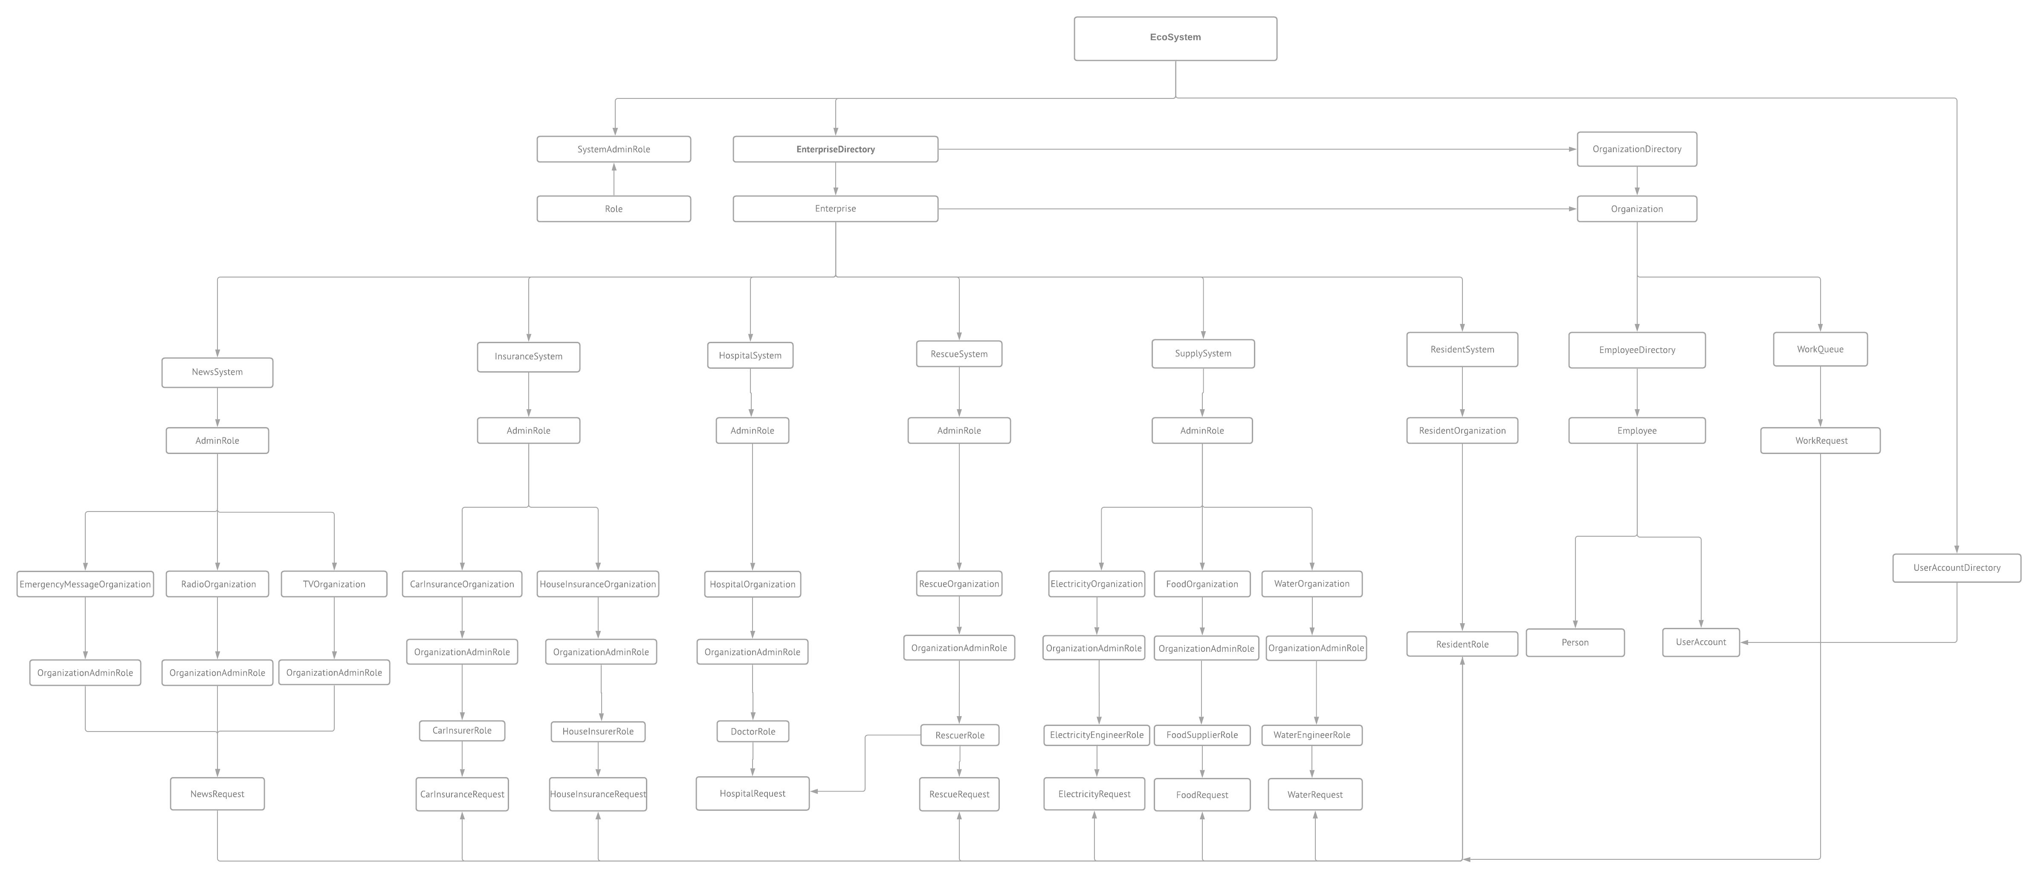
Class diagram

Slide 5
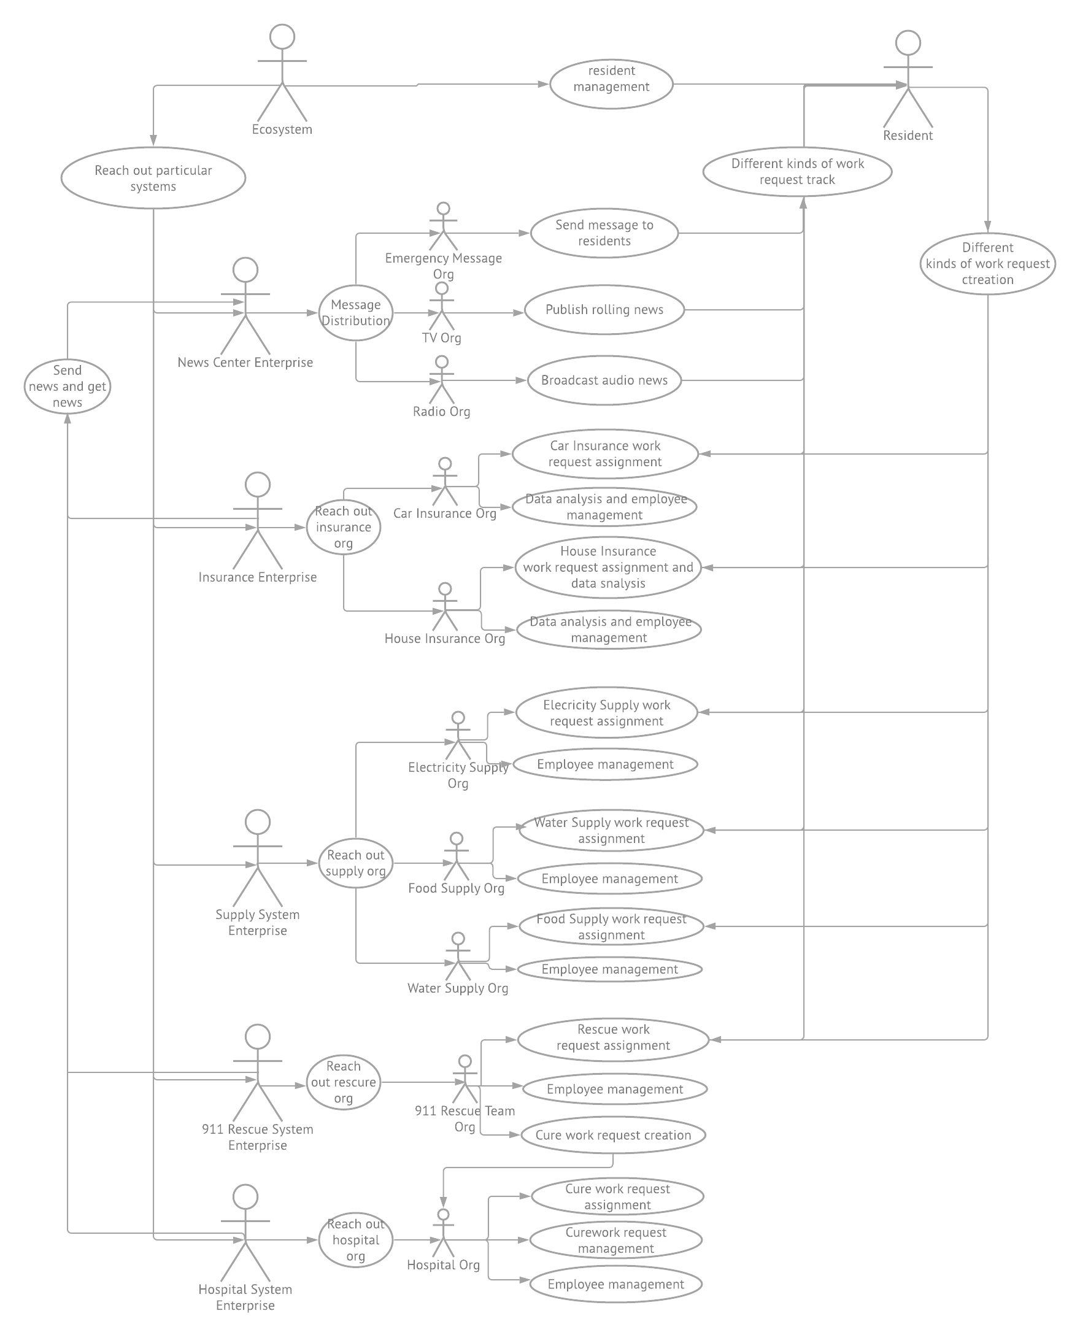
Sequence diagram

Slide 6




Unique Features
Circle Control Ecosystem
By setting different systems, it meets the requirement for a city to manage from resident safety to financial loss analysis, which provides a solution to better-facing typhoons or other severe weather situations.
Multi Interaction
We set a lot of interaction between different systems, like News center would inform residents the updated Typhoon information, 911 staff send request to hospital for emergency action, etc.

Slide 7


Unique Features
Location Visualization
With Geo map embed, users can set location to create workrequest, residents can have a glance of food supply distribution on the map.
Data Analysis
Insurance system make charts on loss amount so that people can get aware of the data.

